Slide 1
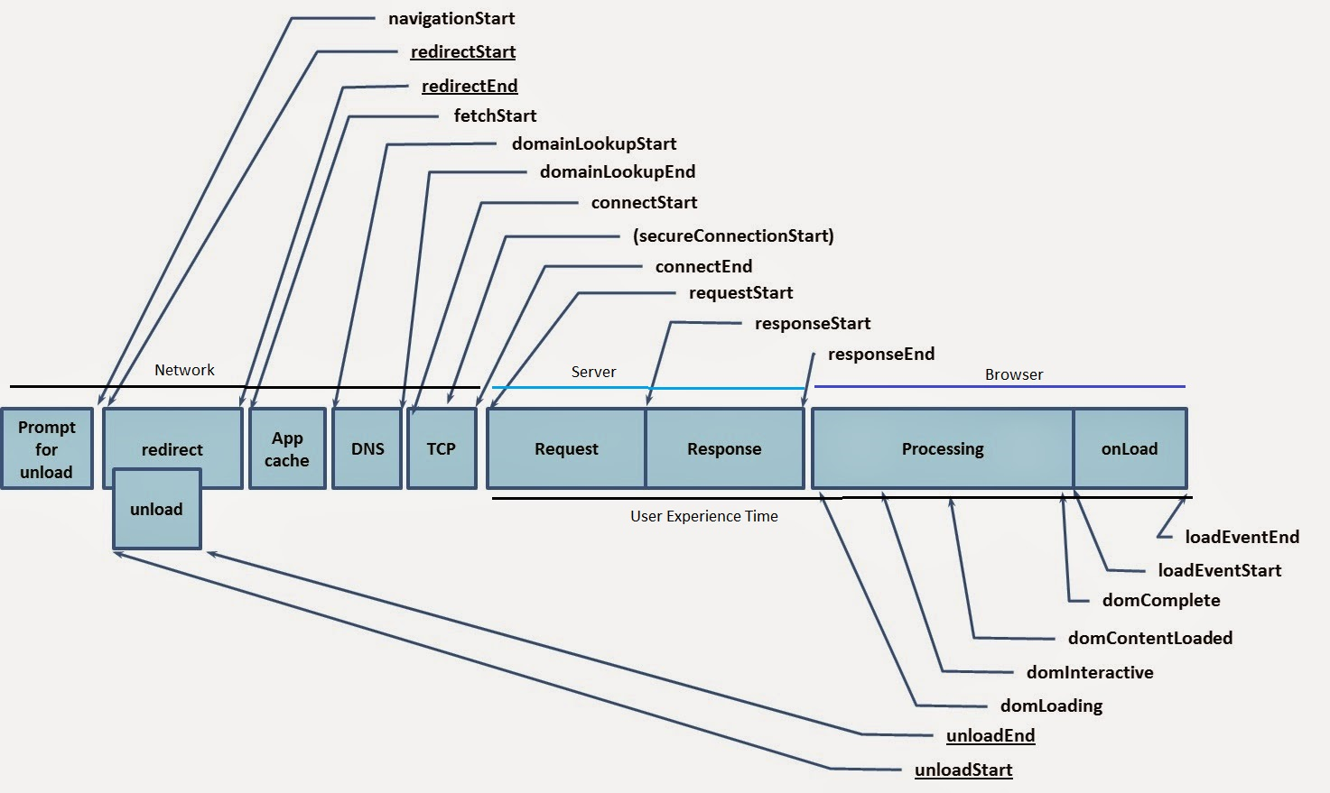
Performance using Navigation Timing API
Web Accessibility
WAVE
GA debug
Nav Timing API
Gatling
LR Discussion

Slide 2

Gatling
Load testing tool - core engine is protocol agnostic
Record, Edit DSL, Launch
Decompress the Gatling bundle and drop simulation files into user-files/simulations folder.
bin/gatling.sh will compile and run the simulation files
gatling-maven-plugin
Analyze Reports over a period - http://gatling.io/docs/2.1.4/general/reports.html
Scenario - written as scripts in conjunction with a DSL
Simulation - how new virtual users will be injected
stdUser.inject(atOnceUsers(2000)), admUser.inject(nothingFor(60 seconds), rampUsers(5) over (400 seconds)), advUser.inject(rampUsers(500) over (200 seconds))
Feeders - inject data from an external source
Web Accessibility
WAVE
GA debug
Nav Timing API
Gatling
LR Discussion

Slide 3
Why Gatling over Jmeter?
Gatling’s clean DSL API (written in Scala) as opposed to the Jmeter’s XML
High performance - Gatling uses asynchronous concurrency (Scala, Akka, Netty) and asynchronous IO.
Gatling is more modern and viable alternative, it appeared on ThoughtWorks technology radar in 2014.
[Gatling jenkins plugin] (https://wiki.jenkins-ci.org/display/JENKINS/Gatling+Plugin) can help to visualize the mean response times:
https://flood.io/blog/11-benchmarking-jmeter-and-gatling
Web Accessibility
WAVE
GA debug
Nav Timing API
Gatling
LR Discussion

Slide 4
Load Runner Discussion
Update to V12.2 on the new Server
1900x web users and 1900x virtual users
Do we have a framework?
Projects that need these vusers?
Live analysis?
Web Accessibility
WAVE
Flow/Concept
Nav Timing API
Gatling
LR Discussion

